Slide 1

ProtoControl
Kelly Mae Allen, Abisha Fenn, Nida Kosedagi, Parker Sexton, William Wood
Notes:
Intro
Example user and how competitors don’t meet their needs
Functional Block Diagrams
System
User Flow
Subsystems
Designing a User Interface
Website
Peripherals
Implementation with User Interface
Integration (command library)
Communication
Microcontroller change
Functionality while systems running
Embedded
PCB
Power
Enclosure
Conclusion
“That’s why Shannon chooses protocontrol”
Demo Day Plans
Demo
Questions

Slide 2
Intro
Example user and how competitors don’t meet their needs
Functional Block Diagrams
System
User Flow
Subsystems
Designing a User Interface
Website
Peripherals
Implementation with User Interface
Integration (command library)
Communication
Microcontroller change
Functionality while systems running
Embedded
PCB
Power
Enclosure
Conclusion
“That’s why Shannon chooses protocontrol”
Demo Day Plans
Demo
Questions

Slide 3
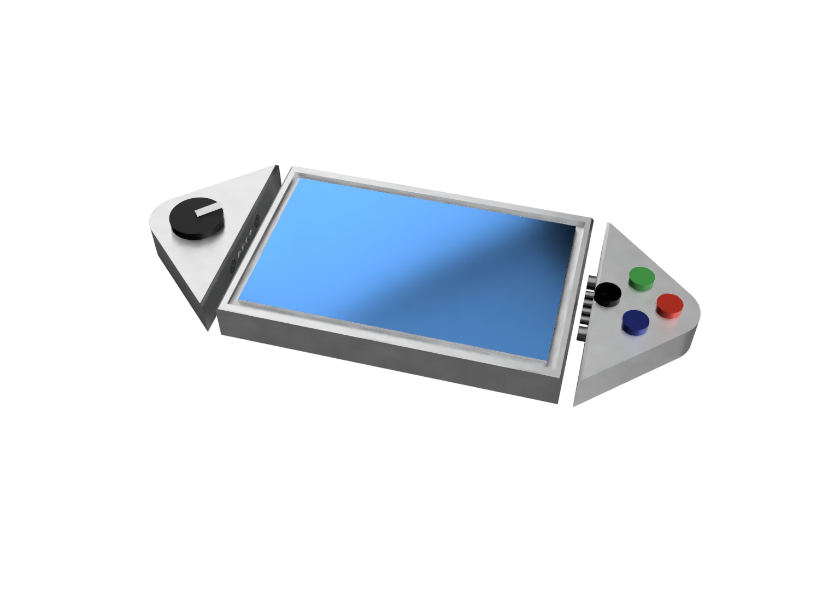
What is ProtoControl?
A plug and play panel with a start-to-finish user interface development experience.
Software platform to design user interface layout
Auto generated embedded code
Touch-screen display
Hot swappable hardware
Compatibility with industry standard technology
Nida Kosedagi
Notes:
Protocontrol allows engineers and hobbyists to execute their vision for a user interface panel with a start-to-finish user interface development experience
Bring the audience to the same place as us before diving into details, set the tone, differentiate ourselves from other projects

Slide 4


Example Users
Shannon
Senior Embedded Engineer
Tasked with designing a test bench for a production line
Needs to have prototype ready ASAP
Julia
10th Grade
Familiar with simple block coding
Wants to make cool projects
Needs to easily display values
Abisha Fenn & Kelly Mae Allen
Notes:
Meet Julia. Julia represents our hobbyist market. Julia is in 10th grade. She has some experience with simple block coding but wants to branch out with some personal projects. Unlike Shannon, her critical constraint isn’t time. She needs something that can manage complexity without having a high barrier to entry.

Slide 5
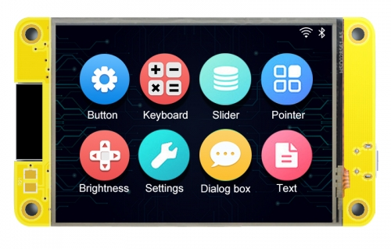
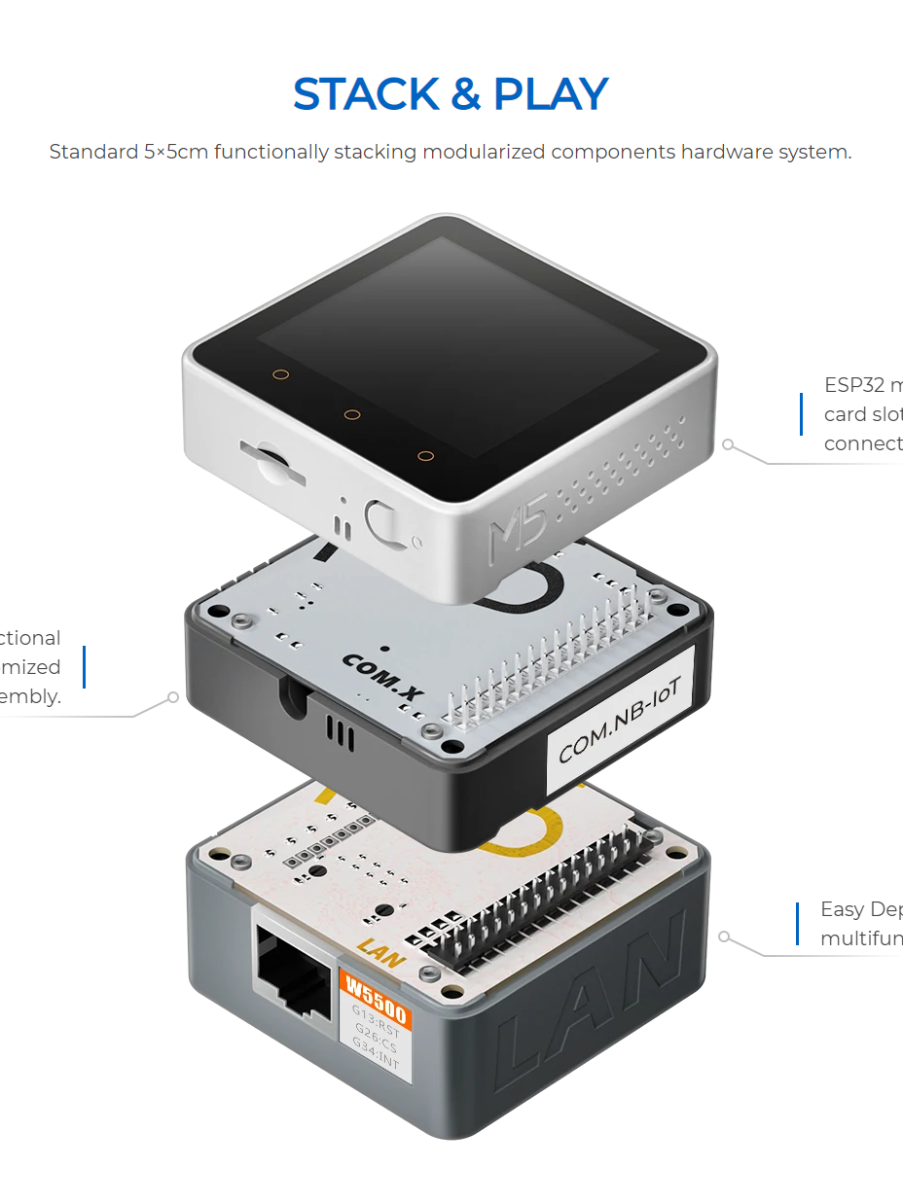
Why ProtoControl?
?
The perfect middle ground between add on screen and all in one
Included microcontroller
We are a service not just a product
Parker Sexton
Notes:
Competitors -

Slide 6





Meet The Team
Kelly Mae Allen (Team Lead)
Enclosure modeling & Power
Embedded software integration
Parker Sexton (Project Sponsor)
Embedded Software Integration
Software/website, Custom PCB design
Will Wood
Software and Website to Design Digital UI
Nida Kosedagi
Custom PCB Design
Serial Communication IC
Abisha Fenn
Serial Communication IC
Enclosure Modeling & Power

Slide 7
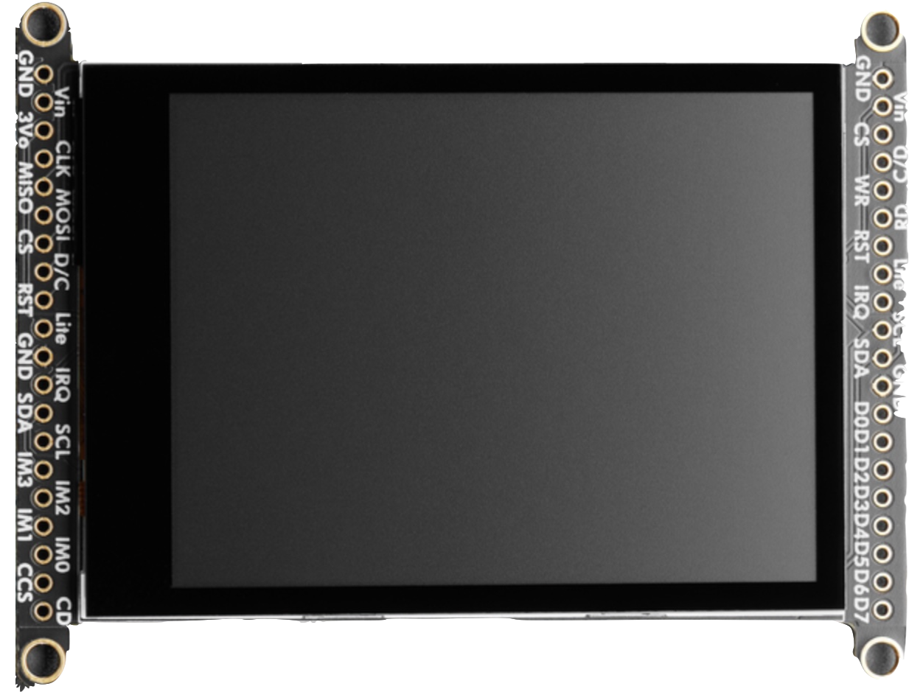
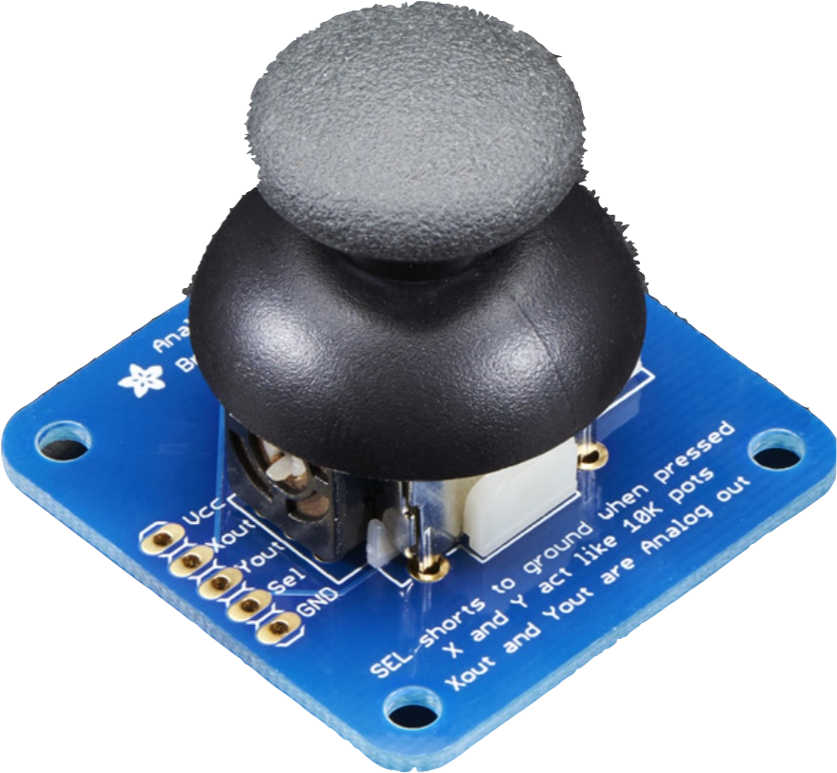
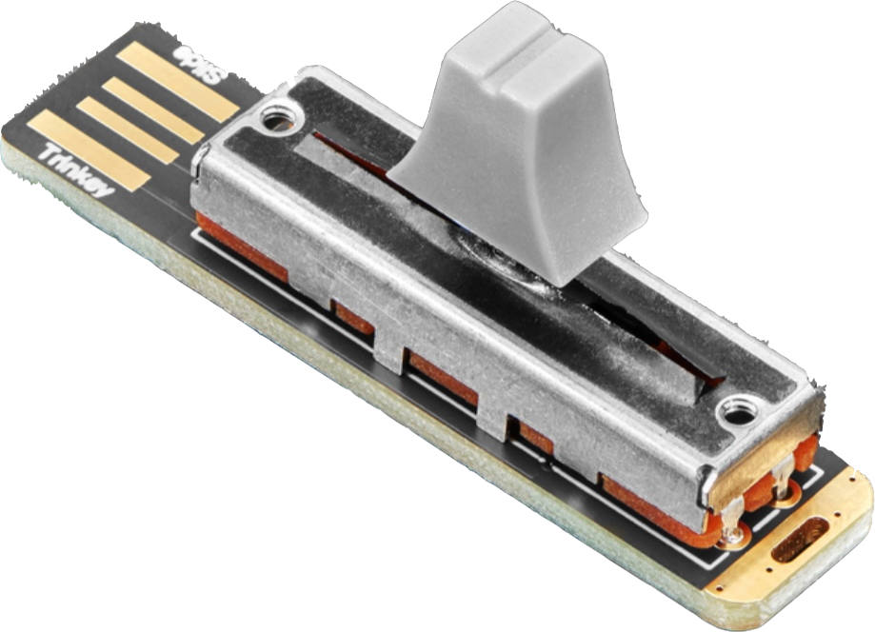
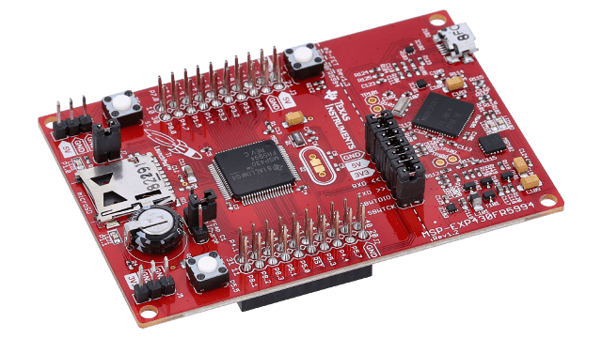
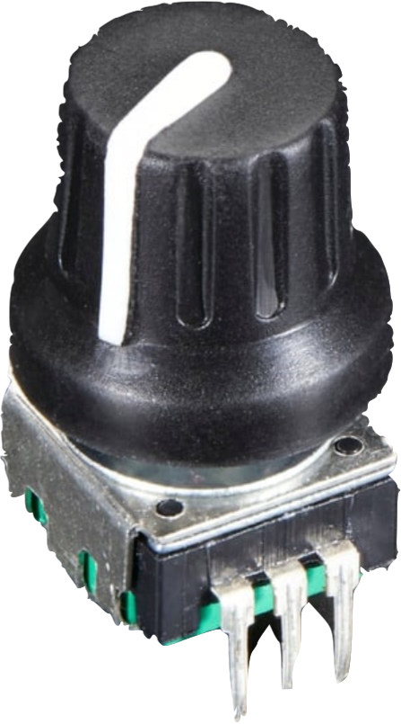
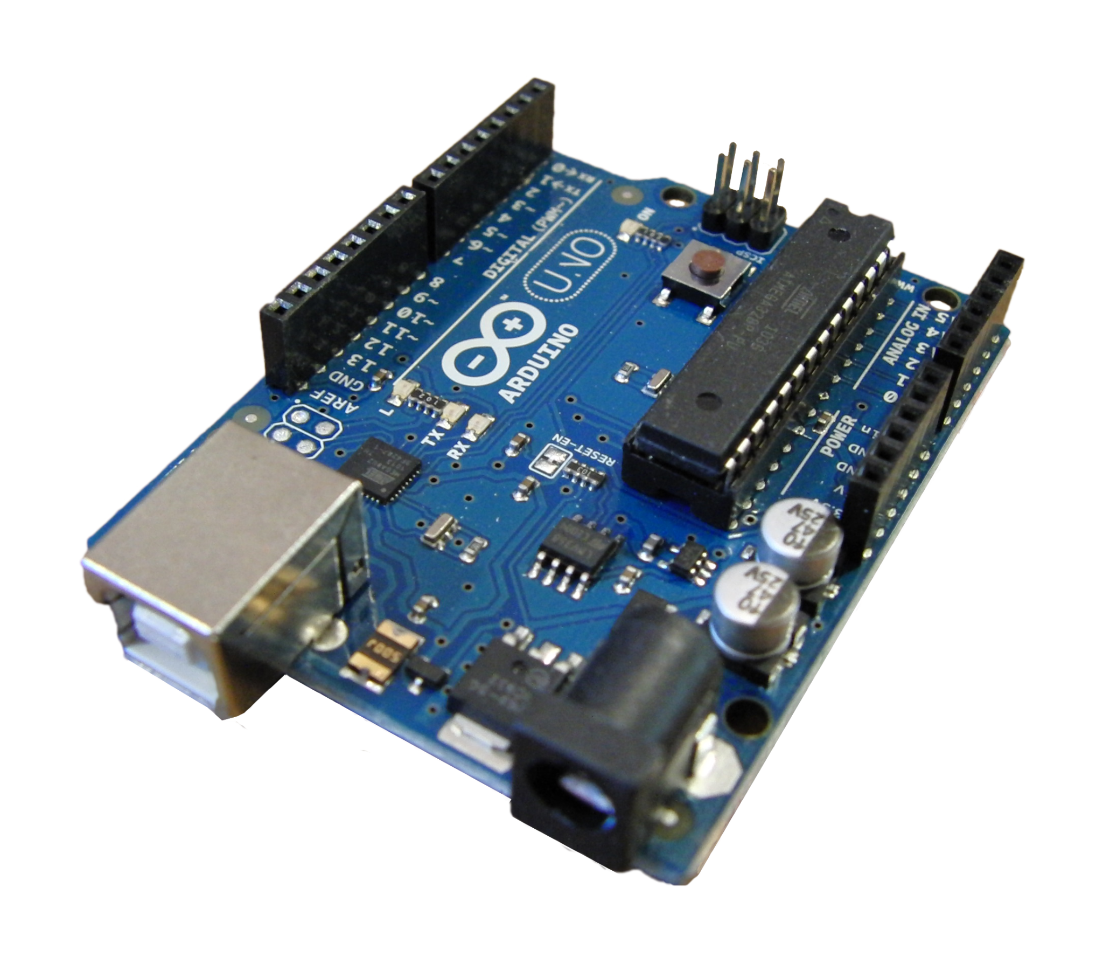
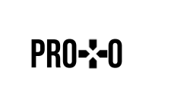
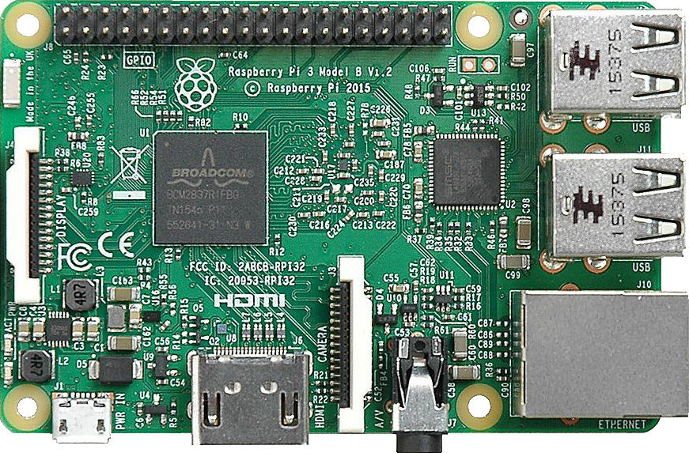
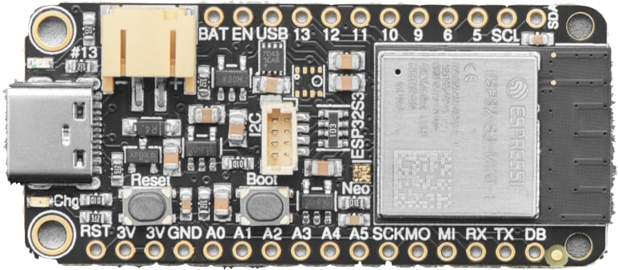
Functional Block Diagram
Display
I2C
I2C Peripherals
SPI
UART
WIFI
User System
Microcontroller
Website

Slide 8
User Flow Diagram
Designing of User Interface
Implementation With User System
Functionality While User System is Running
User Chooses Layout of Components
User Implements Configuration Commands
Protocontrol Monitors UART Channel for Commands
User Configures Component Properties
User Implements Component Output Receiver
Protocontrol Monitors Component State
Website Compiles Placement and Configuration
User Implements Read and Write Commands
Protocontrol Sends Component State Updates
Website Produces Configuration Commands
User Connects System UART Channels
User Monitors UART Channel for Component State
Notes:
Add legend and clip art
Speaker Note:

Slide 9
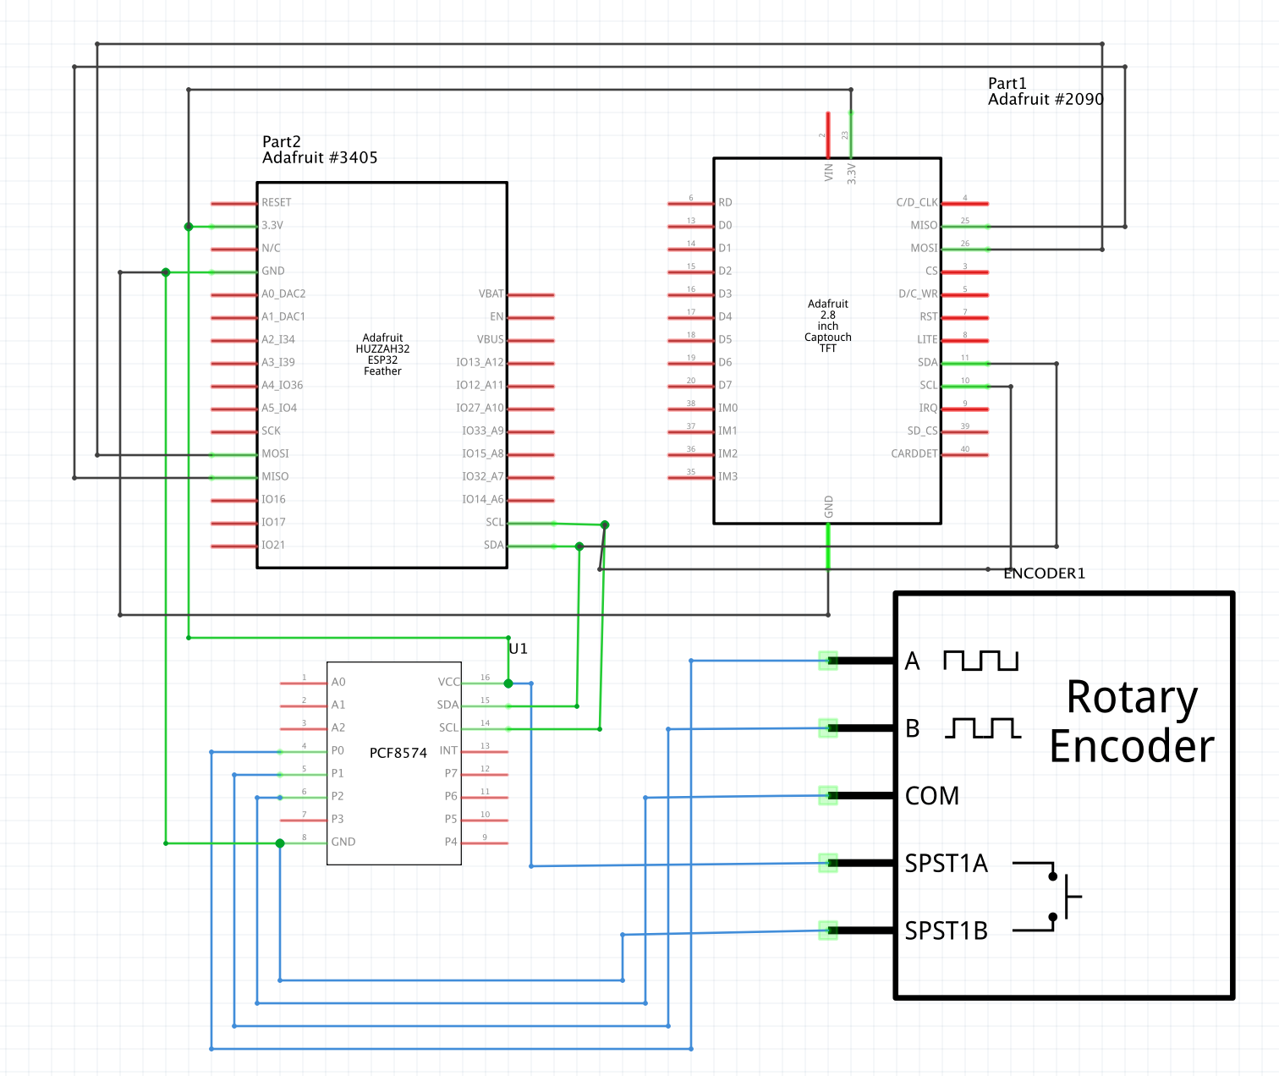
Hardware Diagram
Touchscreen
ESP32 Feather
Blue ~ component PCB
Black ~ Main PCB
Green ~ I2C connectors
pcf8574
Notes:
Enclosure + Component PCB + Component + Pins + screen + PCB + microcontroller (Fritzing)

Slide 10
Subsystems

Slide 11
Website & Software
Will Wood

Slide 12
Software Status Update
Where we left off?
What’s next?
Needed more training data for image recognition
Research web hosting options for website
Brainstorm ways to communicate between website and Protocontrol MCU
Improve YOLO algorithm
Continue development of website
Enable IOT on our device
Will Wood

Slide 13
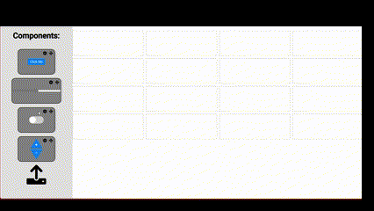
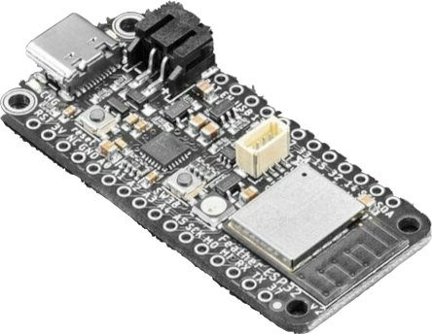
Software Status Update
Where we left off?
What’s next?
Needed more training data for image recognition
Research web hosting options for website
Brainstorm ways to communicate between website and Protocontrol MCU
Improve YOLO algorithm
Continue development of website
Enable IOT on our device
How?
Will Wood

Slide 14

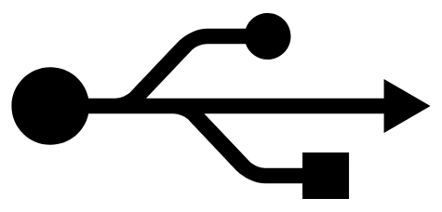

Website Integration with Protocontrol
The search continues for a fast, easy, and reliable way to communicate between our website and our ESP-32
Some things to keep in mind:
Needs to be accessible, the fewer amount of steps involved, the better it is for the end user
Needs to be secure, if data can be easily changed it becomes unreliable
Needs to be simple, if something goes wrong a consumer should be able to debug
How?
Range 🗙
Simple 🗙
Secure 🗙
Accessible ✔
Range 🗙
Simple ⎯
Secure ✔
Accessible ✔
Range ✔
Simple ✔
Secure ✔
Accessible ✔
Will Wood

Slide 15
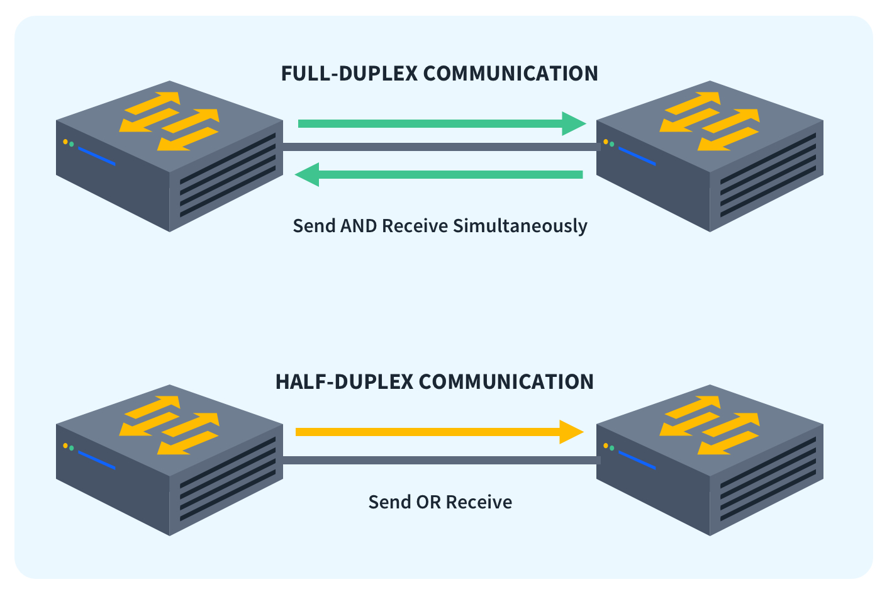
How to Wifi: Part ‘Security’
Security:
Half-Duplex
vs
Full-Duplex
Considerations:
Power draw
Necessity
Frequency of use
Encryption?
Solution: Our own, specifically designed protocol to ensure security and reliability
Will Wood

Slide 16

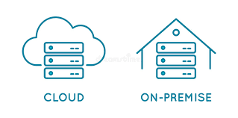
How to Wifi: Part ‘Range’
Considerations:
Maintenance cost
Use cases
Scalability
Necessity
Range:
Local
vs
Global
Solution: A locally hosted web server that allows for quick and easy access from nearby computers
Will Wood

Slide 17
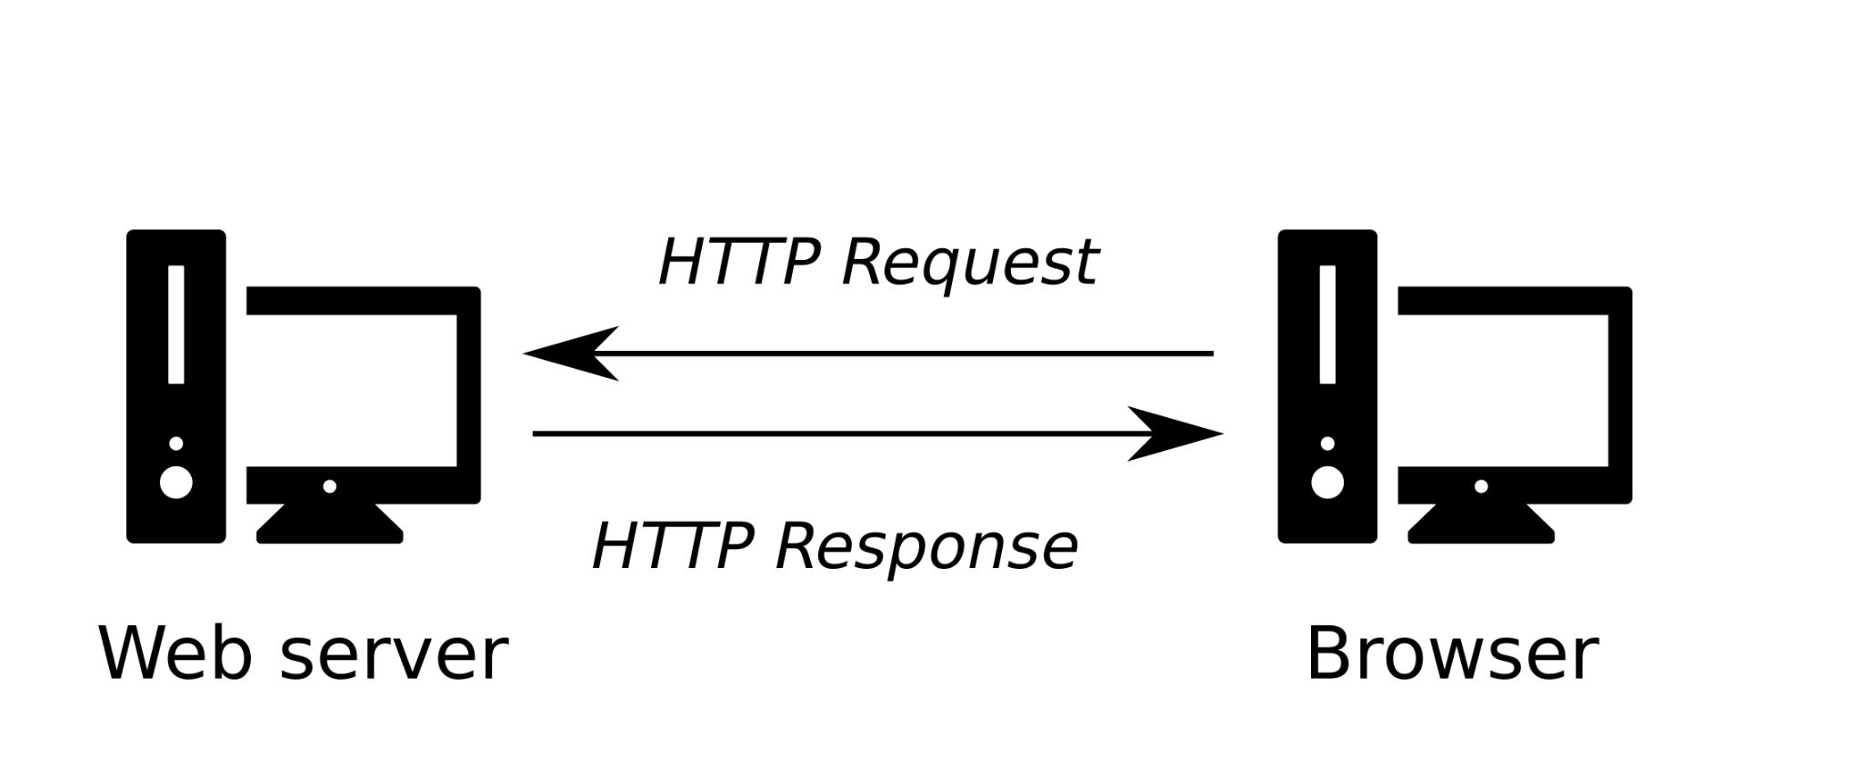
How to Wifi: Part ‘Simplicity’
GET (response)
PUT/POST
GET
Simplicity:
C.R.A.V.E
Solution: A combination of two API’s used in a fashion that allows us to mitigate as many of these issues as possible
Compatibility
Reliability
Accessibility
Vulnerabilities
Ease of Use
Will Wood

Slide 18


How to Wifi: Part ‘Accessibility’
GET (response)
PUT/POST
GET
Accessibility: Selecting a well known, easy-to-use tech stack
Potential Options:
REST API vs GraphQL vs SOAP vs gRPC
Django vs Flask vs PHP
Websocket vs Web Server
Solution: Build a lightweight web server in Python using Flask to act as a REST API backend
Will Wood

Slide 19
Peripherals
Abisha Fenn

Slide 20
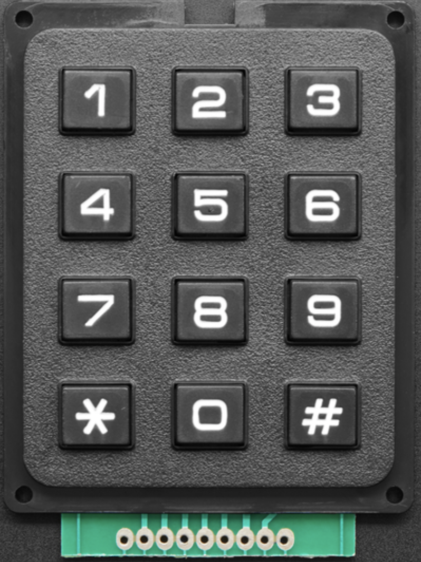
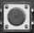
Peripherals
Drag and Drop on Website
Enter Parameters and user system var
Component Choices
Component PCB
 | Slider (0x20) | Keypad (0x21) | Rotary Encoder (0x22) | Arrow Buttons (0x23)
Website Icon
Parameter to the Website | Min, Max | Number of Digits to Expect | Min, Max Tick value | Connect each direction to a function
Abisha Fenn
Notes:
Mention Shannon & Julia
The user will be able to incorporate physical hardware components into their interface.
The user will enter different parameters depending on the specific peripherals into the website (and what variable in their system they are connecting to our peripheral)
These 4 peripherals were selected for their versatility in demonstrating Protocontrol’s features
The slider and rotary encoder could function as substitutes that will demonstrate hot-swapability
We have analog and digital components
Each piece will have its own PCB (to house the pcf8574). The PCB design will essentially be the same in all cases just with pins configured to match the part
Each component has a unique address which allows the system to know which component it is communicating with

Slide 21
Embedded Component Support
Functions
Initialization
digital read
digital write
Current position (slider, rotary encoder, joystick)
Scan
void scanFunc( byte addr, byte result ) {
Serial.print("ADD: ");
Serial.print(addr, HEX);
Serial.print( (result==0) ? " found!":" ");
Serial.print( (addr%4) ? "\t":"\n");
}
Create standardized library files as the case requires
Abisha Fenn
Notes:
Each component will have a script associated with it. This script is part of the total auto-generated code provided by the website once the layout is designed. . It is Each component will be linked to an address

Slide 22
Communication
& Integration
Kelly Mae Allen

Slide 23
Integration between Protocontrol and User System
Developed command protocol for communication between subsystems
+[command]|[parameters]
ex/ sending text from user system
+write|[line]|[start character]|[user text] \n
ex/ sending component state to user system
+out1|[state of component 1]\n
ex/ changing properties of digital components
+init|[component type]|[component location]|[identifier]\n
Integration
of Subsystems
Website
Protocontrol System
User System
Kelly Mae Allen

Slide 24
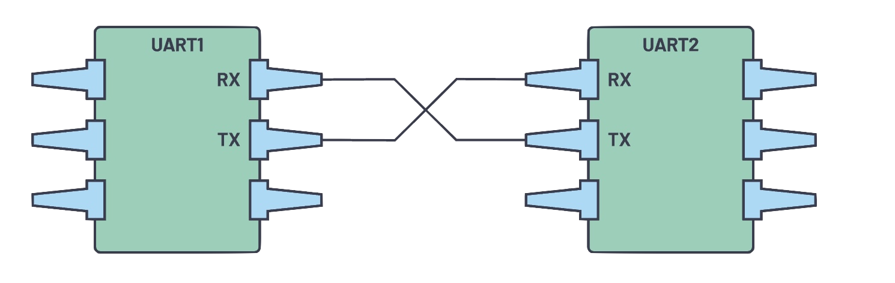


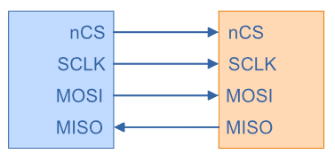
Communication Method Between Protocontrol and User
 | Channel | Link to Protocontrol | Pros | Cons
UART Comm (current configuration) | Hardline Wired Connection |  | - Easy to implement - Freedom of design - Accessible on most Microcontrollers | - Not viable for large messages - Wired connection
TCP via IOT Device | WiFi |  | - Easy and quick to update Protocontrol - Wireless | - Can be unreliable - hard to set up on new network
Bluetooth | Wireless |  | - Easy to use on most computers for user | - Very difficult for user MCU to communicate with Protocontrol
SPI | Hardline Wired Connection |  | - Common protocol - Can easily interface with multiple user MCUs | - Dedicated port with more pins - Learning curve to set up on user MCU
Protocontrol
User MCU
Website
Legend
Kelly Mae Allen
Notes:
Conclusion: Should have IOT and UART as both allow for simplest interaction with user for protocontrol update and setup and running operation respectively
ADD: Make a note of data handling and

Slide 25
Embedded System
Parker Sexton

Slide 26
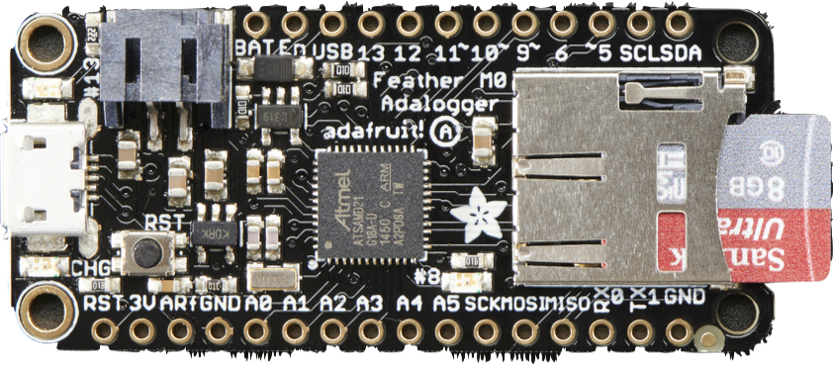
Parker Sexton
Old Microcontroller
New Microcontroller
Our Big Communications Change

Slide 27
Decision matrix
 | Cortex M0 Adalogger | ESP32 Feather
Chip Type | ATSAMD21G18 @ 48MHz | ESP32 Dual core 240MHz Xtensa® processor
Communication | SD card slot | IOT capabilities
Power Port | Micro USB power | USB - C power
Memory | 256KB of FLASH + 32KB of RAM | 8 MByte of Flash and 2 MByte of PSRAM
Form Factor | Adafruit Feather | Adafruit Feather
Parker Sexton

Slide 28
IOT update
New Microcontroller with ESP32
IOT communication
Maintained form factor - same pcb
Successfully transferred embedded code
WIFI communication working
Parker Sexton
Notes:
Lost no progress, only opened up doors

Slide 29
Embedded Communication Implementation
User MCU
if(Serial1.available()){
msg = Serial1.read();
if(msg == '+out1')
display(out1);
UART
Protocontrol
while (client.available()) {
char c = client.read();
Serial.write(c);
}
IOT
Website
Parker Sexton

Slide 30
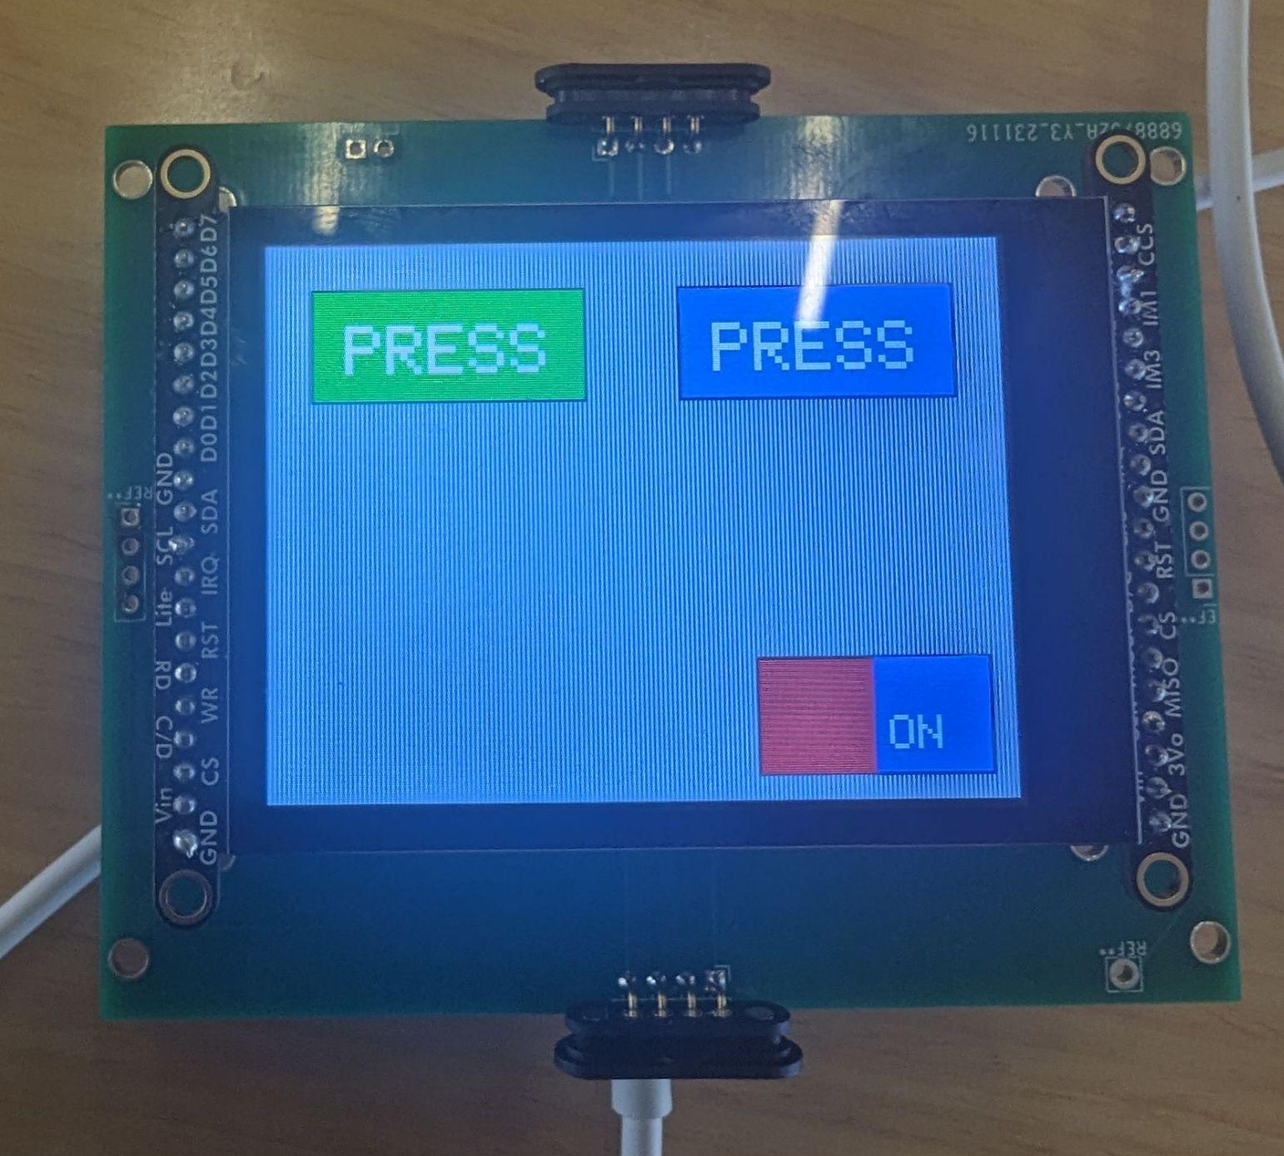
Embedded Algorithm
Serial message
PushButton,20,20,0x780F,0xC618,PRESS,|,PushButton,20,180,0xFFFF,0xC618,PRESS,|,Toggle,200,120,0xF800
Custom Algorithm
Class Functions for Toggle:
drawToggle()
handleTouch()
this->state
Parker Sexton

Slide 31

Embedded integration
I2C component initialization
Console display
Dual Serial Monitoring
Handling touch inputs
Robust, abstracted software
Parker Sexton

Slide 32
Power
Max 500mA
Operating power & requirements
Battery Stuff
User power requirements

Slide 33
PCB &
Circuit Design
Nida Kosedagi

Slide 34
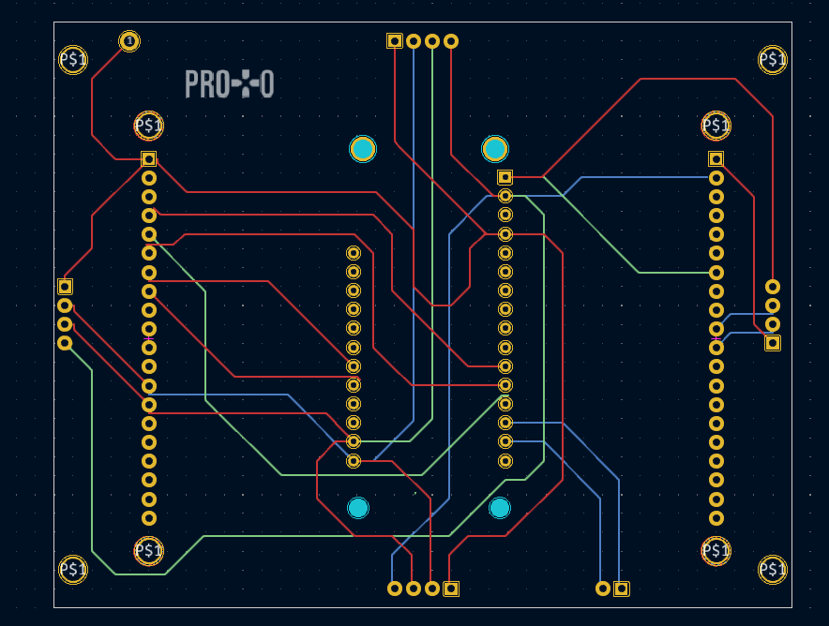
PCB design updates
Progress & Status:
- Main PCB works even when we switch MCUs
- New main board design in progress to accommodate new ideas such as…
Two Layer PCB
SD card
USB port
Power pin
Ergonomic design
Nida Kosedagi
Notes:
Split this into a couple slides

Slide 35
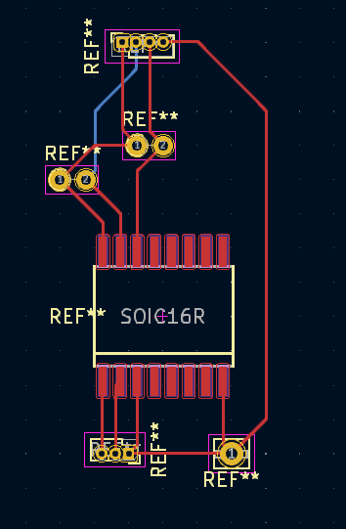
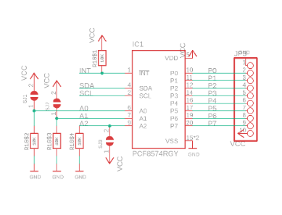
PCB design progress
Progress & Status: Component PCB designed, enables PCF8574 to process I2C input and communicate that to the MCU via main PCB.
Nida Kosedagi
Notes:
Split this into a couple slides

Slide 36
PCB design progress
Next steps:
Stepping into the power management for USB port and power pin design
Printing and testing the component PCB with I2C components
Finalize the new main board design and print
Nida Kosedagi
Notes:
Split this into a couple slides

Slide 37
Enclosure
& Power System
Kelly Mae Allen

Slide 38
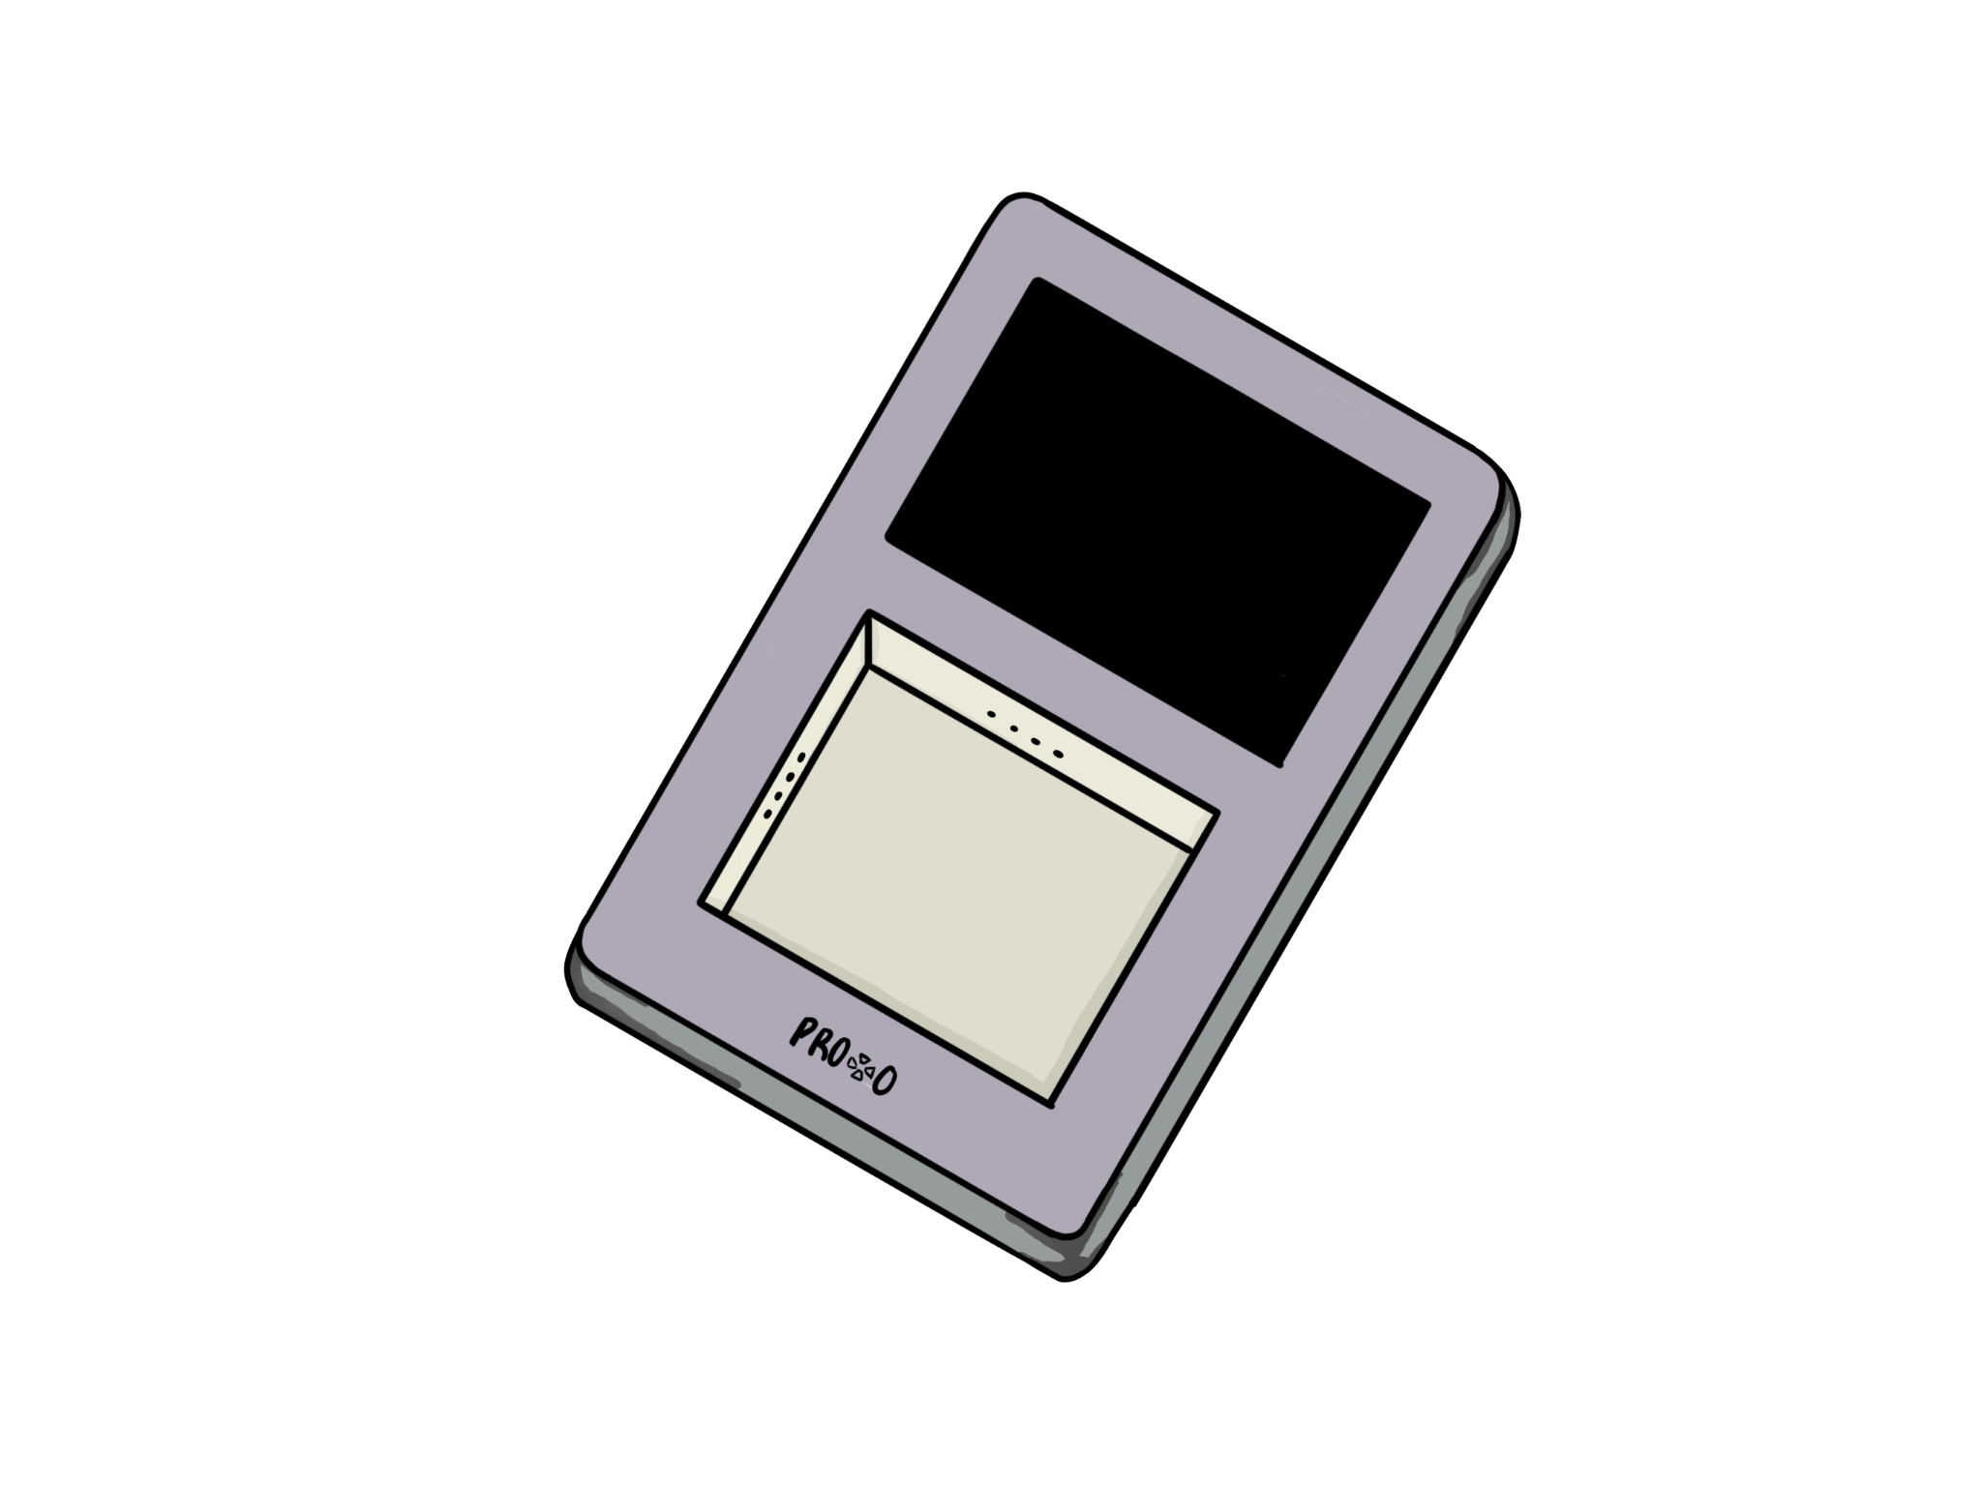
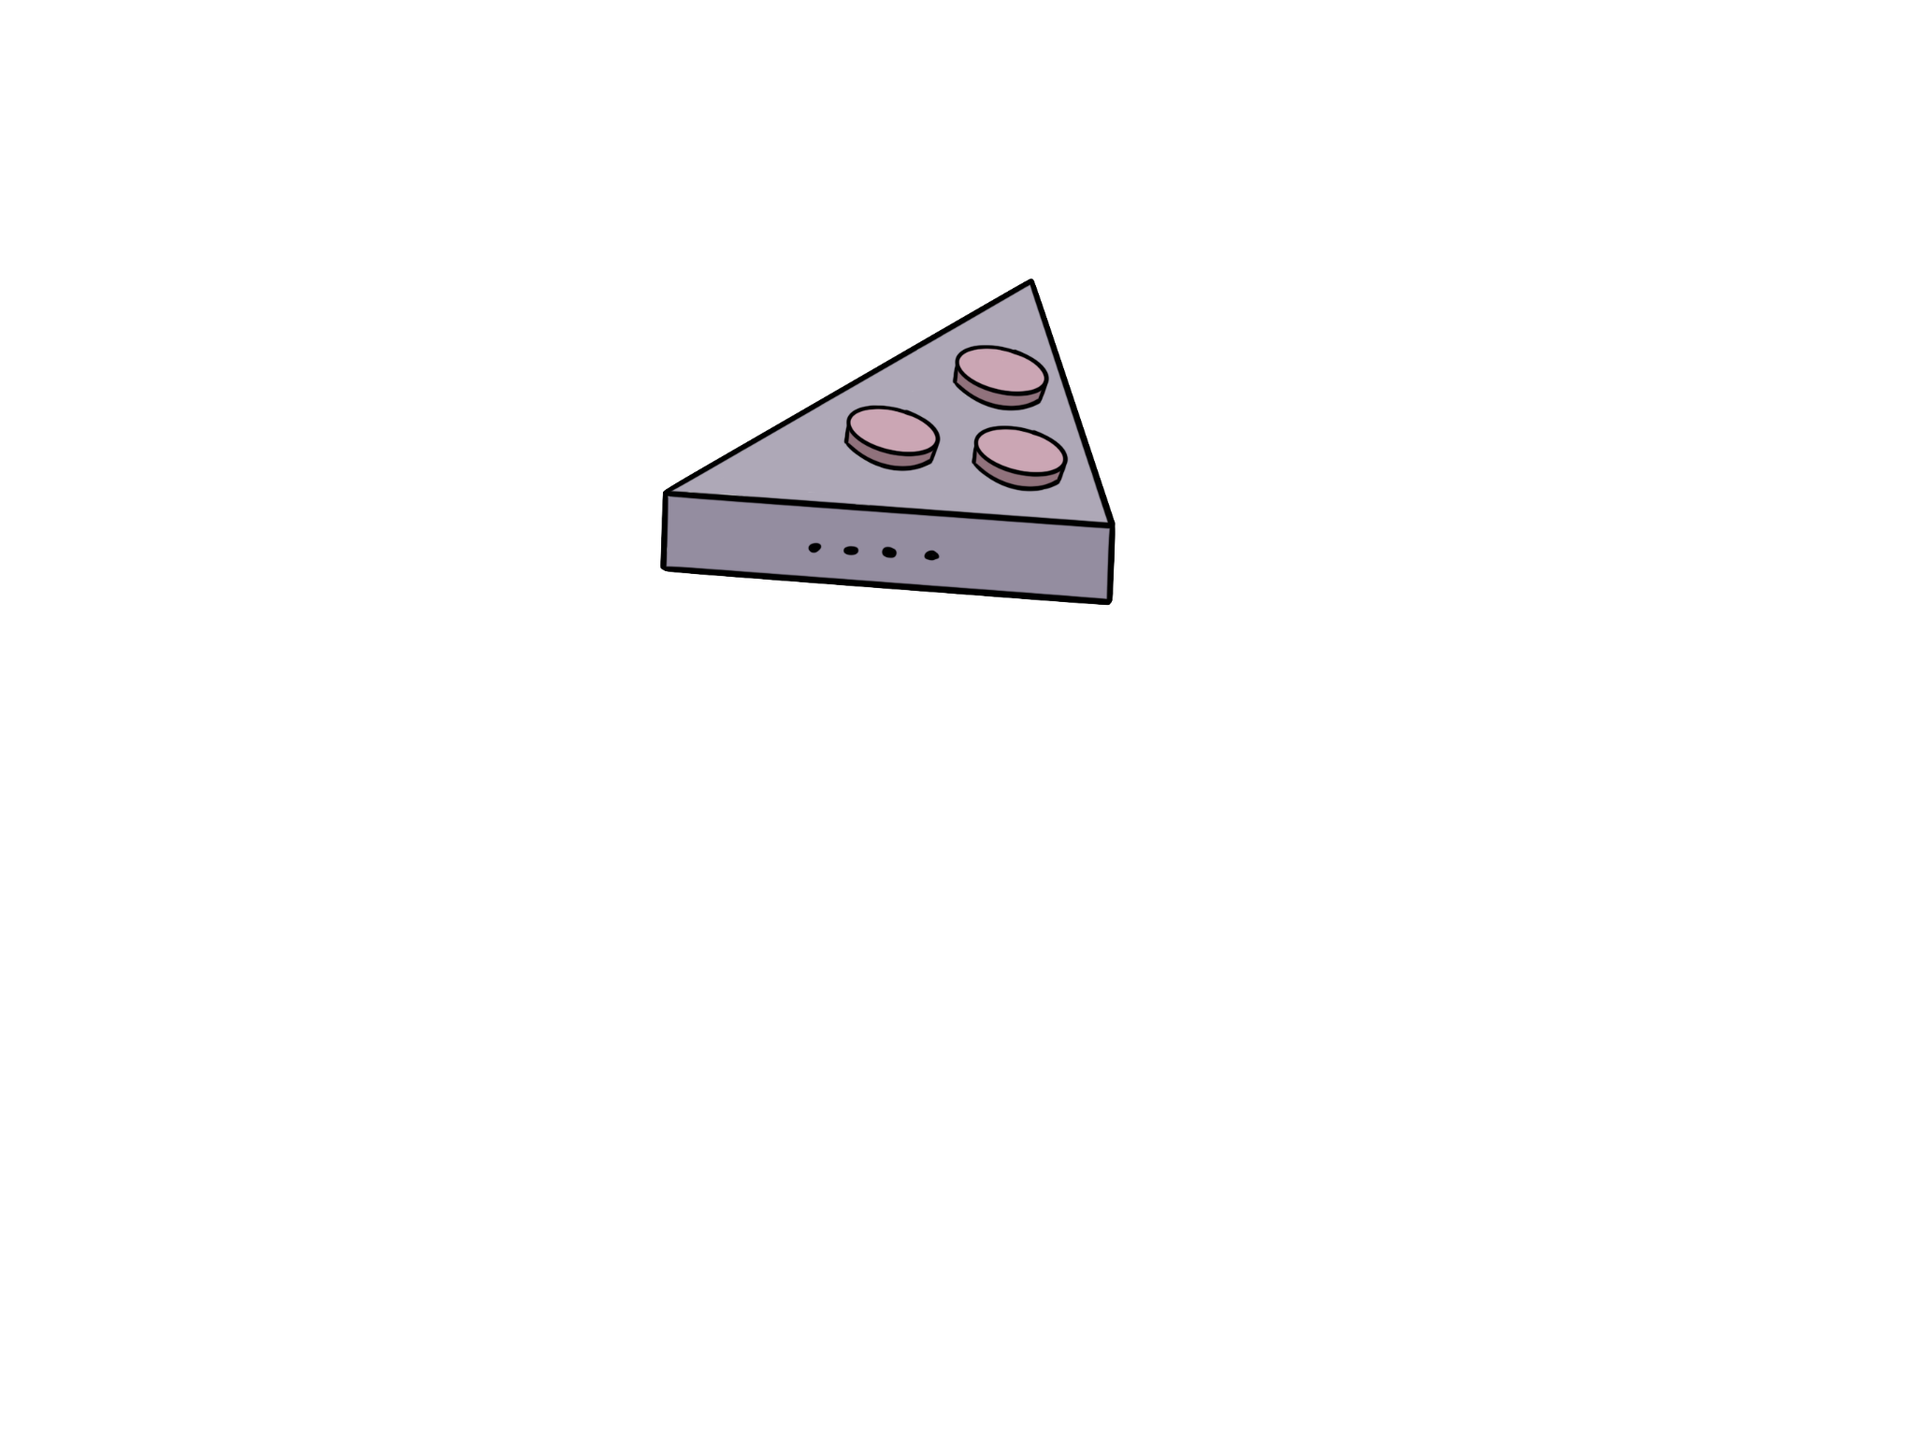
Enclosure Design Update
Access to power
Access to Tx & Rx pins
Access to I2C ports
Robust & Durable
Current Design
New Design
Kelly Mae Allen
Notes:
Talk about Guides

Slide 39
Bill of Materials
Part description | Part number | Qty | Unit Price | Total Price | Vendor
PCB
Main PCB | W202311150946657 | 1 | $1.40 | $1.40 | JLCPCB
Serial Communication
TI GPIO expander | 296-13109-5-ND | 4 | $2.57 | $10.28 | Digikey
Embedded Systems
MicroController | 5400 | 1 | $19.95 | $19.95 | Digikey
capacitive touchscreen | 1528-2848-ND | 1 | $29.95 | $29.95 | Digikey
I2C Components
Stemma Slider | 5295 | 1 | $9.95 | $9.95 | Adafruit
Rotary Encoder | 377 | 1 | $4.50 | $4.50 | Adafruit
Buttons | 1119 | 4 | $0.25 | $1.00 | Adafruit
Keypad | 3845 | 1 | $6.50 | $6.50 | Adafruit
Now for ONLY
$83.53
Total Cost
Kelly Mae Allen

Slide 40
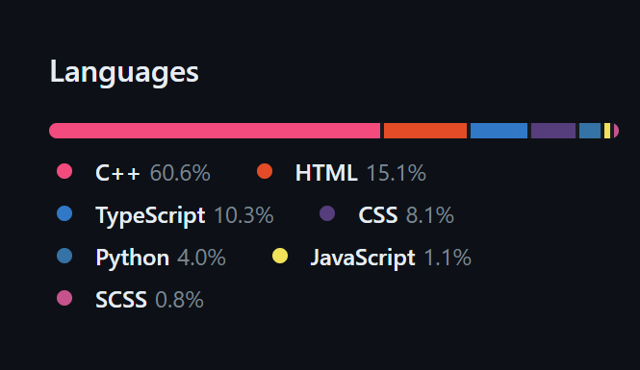
GitHub

Slide 41
Power Management
Component | MCU & Touch Screen | GPIO Expander | Rotary Encoder | Stemma Slider | Total:
+5V [mA] | 140 | 25 | 10 | 9.6 | 184.6
Power [W] | 0.700 | 0.125 | 0.050 | 0.048 | 0.933
Kelly Mae Allen

Slide 42
Summary of Subsystem Progress and Goals
Website
- thing one
Peripherals
- thing one
Comm & Integration
- thing one
Embedded System
- thing one
PCB & Ckt Design
- thing one
Enclosure & Pwr Sys
- thing one

Slide 43
Demo Day Plans

Slide 44
Integration between Protocontrol and User System
Kid designing “security system” for room
User Peripherals:
Motion detector
Speaker
Lights
Protocontrol:
Control volume (slider)
Activate/deactivate system
View System State (touchscreen)
Select Lights Color (touchscreen)
User System Designed with the following features in mind:
User: Hobbyist
MCU: Arduino
Adv. of Protocontrol: Manage complexity w/ limited coding
Abisha Fenn & Kelly Mae Allen
Notes:
Demonstration Points
User: hobbyist
Arduino
Why is protocontrol the best choice for this project? What purpose does it serve (control volume, manage complexity (use existing sketches), activate/deactivate system, select lights color?, state LED)
Hardware Peripherals included: slider volume, keypad (lock?)
Alpha, Beta
This user system is designed to demonstrate the features of protocontrol that a hobbyist would find useful

Slide 45
Integration between Protocontrol and User System
Shannon - Industry Professional
Julia - Hobbyist
Goal: Design a test bench ASAP that can be easily updated
MCU: TI MSP 430
UI Req:
- Display temperature and voltage
- Start test cycle
- Show pass/fail
Protocontrol Implementation:
Design display screens
Send data over UART during operation
Goal: Design a room security system with limited complexity
MCU: Arduino Uno
UI Req:
- Activate/deactivate system
- Control speaker volume and lights
- View system state
Protocontrol Implementation:
Design display screens & choose peripherals
Send data over UART

Slide 46
Lab Bench Demo

Slide 47
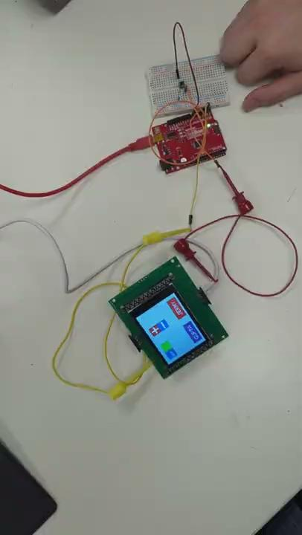
UART Communication Demo

Slide 48
Questions?
Thank You!

Slide 49
A plug and play panel with a start-to-finish user interface development experience
Software Support
Embedded System
User Designs Layout
Init Components
Convert to embedded code
Draw Static Images
Communicate with device
Init Components
Poll Auxiliary Components
Interface with user
Update Console
Design Challenges
Compatibility with multiple MCUs
Generating working embedded code
Controlling user system
Key features
Napkin-to-UI
No embedded knowledge needed
Plug and Play design
Serial communication protocol
Interchangeable tactile buttons, knobs, and sliders
Dedicated power supply

